Slide 1

AWS Compute and Serverless Services

Slide 2
Compute & Serverless Services
Amazon EC2 — virtual servers
Elastic Beanstalk — managed application platform
Amazon Lightsail — simple cloud servers
AWS Lambda — serverless computing

Slide 3
What is Cloud Computing?
Computing resources available on demand
Traditional: Buy → Install → Configure → Maintain
AWS: Choose resources → Launch → Deploy → Scale
Resources include CPU, memory, storage and networking
Main benefit: pay for resources as needed

Slide 4
Amazon EC2
Elastic Compute Cloud provides virtual servers in AWS
Control CPU, memory, OS, storage and networking
Common uses: web servers, application servers, databases and development
Think: a computer/server in the AWS Cloud that you control

Slide 5
EC2 Instance Types
General Purpose — balanced CPU and memory
Compute Optimized — CPU-intensive workloads
Memory Optimized — memory-intensive workloads
Storage Optimized — high-performance storage workloads
Accelerated Computing — GPU/accelerator workloads

Slide 6
Amazon Machine Image (AMI)
AMI is a template used to create EC2 instances
Can contain OS, applications and configuration
One AMI can launch multiple similar EC2 instances

Slide 7
EC2 Pricing Models
On-Demand — flexible, pay as you use
Reserved/Savings Plans — commitment for lower cost
Spot Instances — lower-cost spare capacity; may be interrupted
Dedicated options — dedicated physical resources for specific requirements

Slide 8
EC2 Key Pairs
Key pair consists of public key and private key
Used for secure EC2 access
Linux: commonly used with SSH
Windows: can be used to retrieve/decrypt administrator password
Never share or expose the private key

Slide 9
EC2 Tenancy
Default/shared tenancy — standard option
Dedicated Instance — hardware dedicated to a customer
Dedicated Host — entire physical host dedicated to a customer
Choose based on compliance, licensing and isolation requirements

Slide 10
Auto Scaling Fundamentals
Automatically adjusts compute capacity based on demand
Scale Out — add instances
Scale In — remove instances
Improves performance, availability and cost efficiency

Slide 11

Scaling Strategies
Vertical scaling — increase the size/power of one server
Horizontal scaling — add more servers
Load Balancer distributes traffic
Horizontal scaling is commonly used for highly available applications

Slide 12
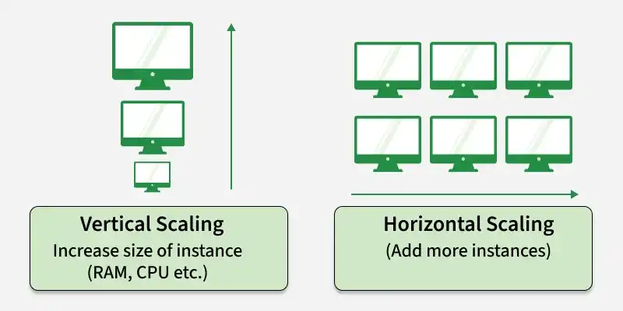

Slide 13
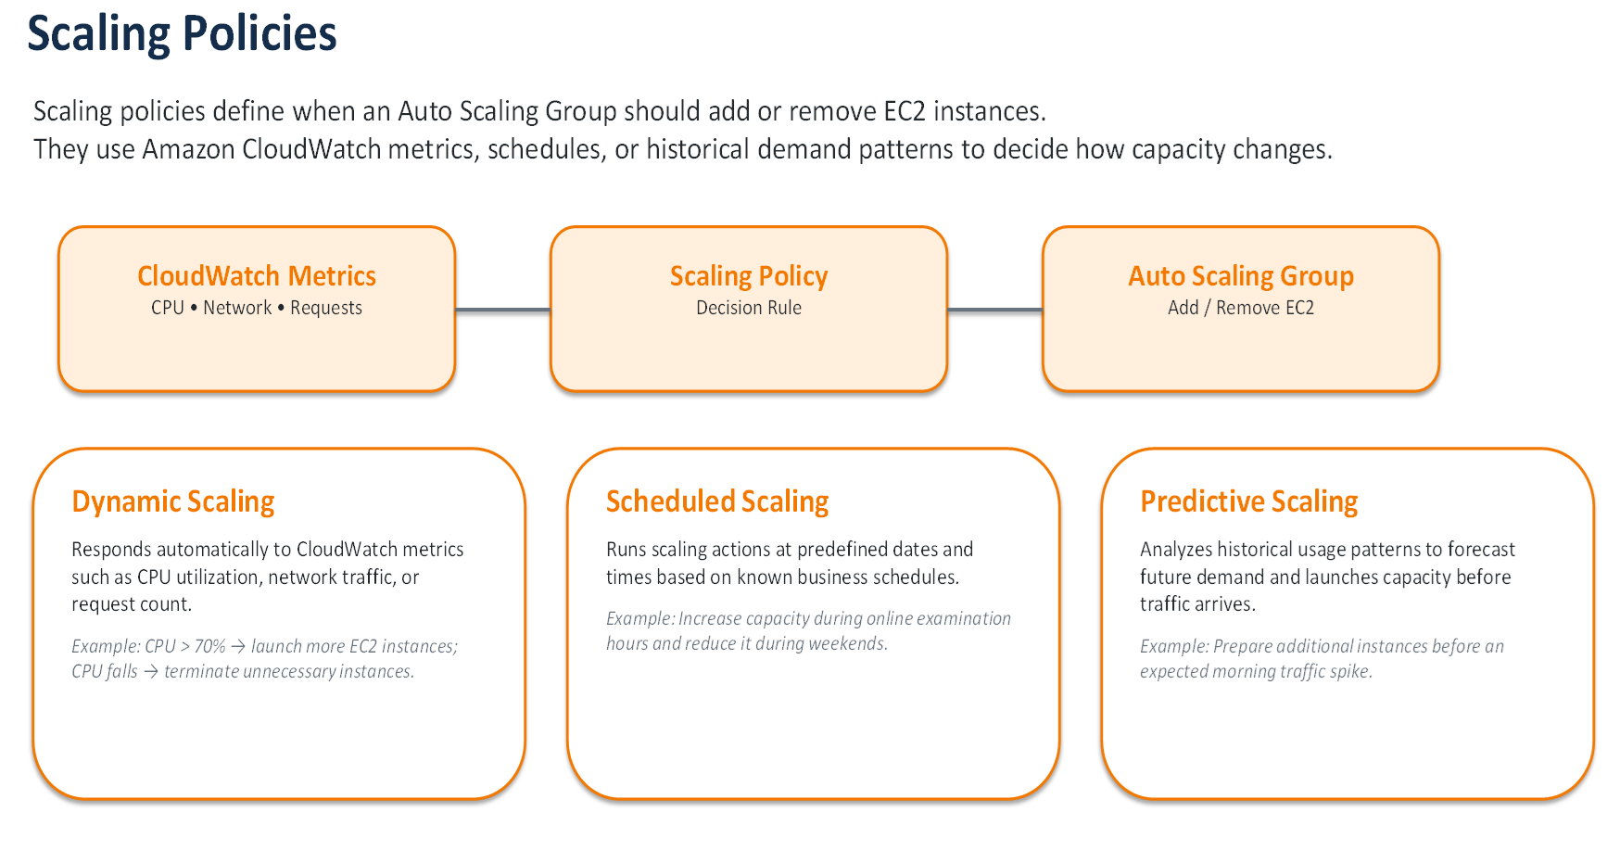

Slide 14
AWS Elastic Load Balancing
What is AWS Elastic Load Balancing?
  Elastic Load Balancing (ELB) automatically distributes incoming application traffic across multiple targets such as EC2 instances.
  Helps improve availability, scalability, performance, and fault tolerance.
Benefits:
  Prevents a single server from becoming overloaded.
  Improves application availability and reliability.
  Distributes traffic across multiple Availability Zones.
  Supports health checks and automatic traffic routing.
Problems without Load Balancing:
  Single point of failure.
  Server overload during traffic spikes.
  Poor performance and possible downtime.
  Difficult to scale applications efficiently.
Types of AWS Load Balancers
  Application Load Balancer (ALB): HTTP/HTTPS and application-level routing.
  Network Load Balancer (NLB): High-performance TCP/UDP/TLS traffic.
  Gateway Load Balancer (GWLB): Network and security appliances.
  Classic Load Balancer (CLB): Older/legacy workloads.

Slide 15
Target Groups & Auto Scaling
Target Groups
  A Target Group contains the backend resources that receive traffic from the load balancer.
  Targets can include EC2 instances, IP addresses, containers, and supported Lambda targets.
  Performs health checks to identify healthy and unhealthy targets.
  Traffic is normally routed only to healthy targets.
Load Balancer + Auto Scaling
  Load Balancer: Distributes incoming traffic across available targets.
  Auto Scaling: Automatically adds or removes instances based on demand.
Together they provide:
  High availability
  Automatic scalability
  Better performance
  Fault tolerance
Simple Architecture: Users (Auto Scalling) → Load Balancer → Target Group → EC2 Instances

Slide 16
Elastic Beanstalk
Managed application platform
Developer provides application code
AWS manages much of the infrastructure
Can provision EC2, load balancing, Auto Scaling and health monitoring
Useful when developers want simpler deployment

Slide 17
Elastic Beanstalk: Worker Environment & Deployment Strategies
Worker environments process background jobs asynchronously, while deployment strategies control how new application versions are released.
1 WORKER ENVIRONMENT
Amazon SQS Queue
Worker EC2 Instances
Pull → Process → Complete
Background Job
Used for asynchronous tasks such as image processing, report generation, email processing, or long-running jobs.
2 DEPLOYMENT STRATEGIES
Rolling Deployment
Immutable Deployment
Update instances in batches.
Old + New versions temporarily coexist.
Create a completely new set of instances with the new version.
Test the new environment, then switch to it.
Lower downtime • Gradual rollout
Safer releases • Easy rollback

Slide 18

Amazon Lightsail
Simple cloud computing service
Suitable for websites and small applications
Easy setup and predictable pricing
Fewer advanced configuration options than EC2
Think: simple cloud server vs. highly configurable EC2

Slide 19
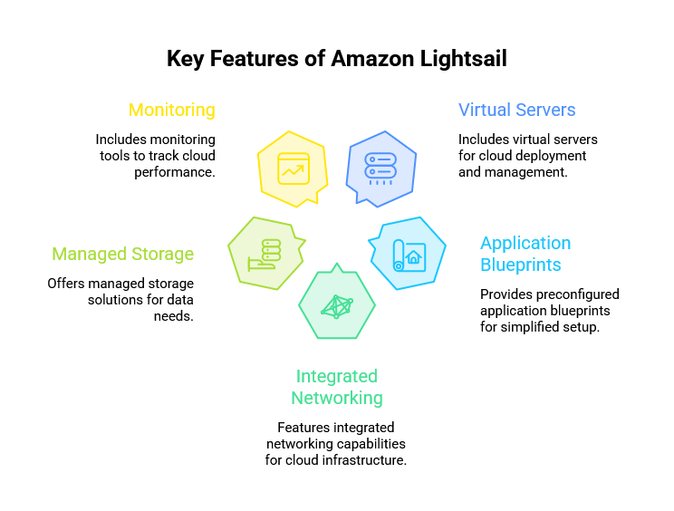

Slide 20
Compute Scalability & Availability
Use multiple Availability Zones
Use Auto Scaling
Use Load Balancers
Configure health checks
Use backup and recovery strategies

Slide 21

What is Serverless?
Serverless does not mean there are no servers
AWS manages the underlying infrastructure
Developers focus mainly on application code
Benefits: less server management, automatic scaling and usage-based pricing

Slide 22
AWS Lambda
Runs code without managing servers
Triggered by events
AWS handles servers, operating system and scaling
Examples: file processing, APIs, automation and security responses

Slide 23
How Lambda Works
Event → Lambda Function → Result
Events can come from S3, APIs, databases, schedules, queues and IoT
Example: S3 upload triggers image processing Lambda

Slide 24

Event-Driven Architecture
An event means something happened
Examples: account created, file uploaded, payment completed, order placed
Components respond to events independently
Benefits: flexibility, scalability and loose coupling

Slide 25
Serverless Application Architecture
Typical flow: User → API Gateway → Lambda
Lambda can interact with DynamoDB and S3
Reduces the need to manage EC2 servers
Suitable for APIs and event-driven applications

Slide 26
Serverless Deployment
Write code → Test → Package → Deploy → Configure trigger → Monitor
Deployment options: AWS Console, AWS CLI, Infrastructure as Code and CI/CD
Use development, testing and production stages

Slide 27
Serverless Monitoring
Monitor invocation count, duration and concurrency
Track errors and timeouts
Use CloudWatch for metrics, logs and alarms
Use AWS X-Ray for distributed request tracing

Slide 28
Serverless Use Cases
Web applications and APIs
File processing
Scheduled automation
Security event processing
Data processing and notifications
IoT event processing

Slide 29
Serverless Limitations
Execution/runtime limits
Cold starts
Stateless execution model
Distributed applications can be harder to troubleshoot
Potential vendor dependency
Not always the most economical choice for continuously running workloads

Slide 30
EC2 vs Beanstalk vs Lightsail vs Lambda
EC2 — maximum control and customization
Elastic Beanstalk — easier managed application deployment
Lightsail — simple cloud server
Lambda — event-driven serverless execution
Compare control, management effort, scaling and workload type

Slide 31
Real-World Architecture
E-commerce example
Users → Load Balancer → EC2 Auto Scaling
Deploy EC2 instances across Availability Zones
Use Lambda for order events, notifications or background processing
Architecture combines traditional compute and serverless

Slide 32
AWS Compute Best Practices
Choose the right instance type
Monitor CPU, memory and network usage
Use Auto Scaling and multiple Availability Zones
Use IAM roles, security groups and protected keys
Right-size resources and choose suitable pricing models
Monitor with CloudWatch and automate deployments

Slide 33
Quick Decision Guide
Need complete server control → EC2
1
Want managed application deployment → Elastic Beanstalk
2
Need a simple small cloud server → Lightsail
3
Need code to run on events → Lambda
4

